Slide 1

Reservoir Water Level Analysis using Random Forest.

Slide 2
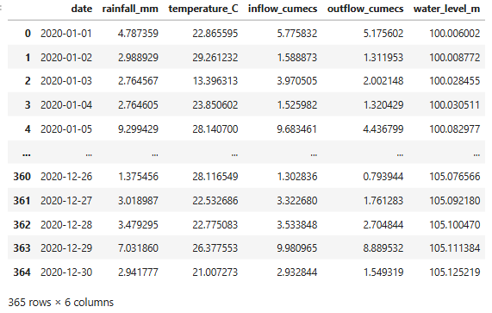
Dataset

Slide 3
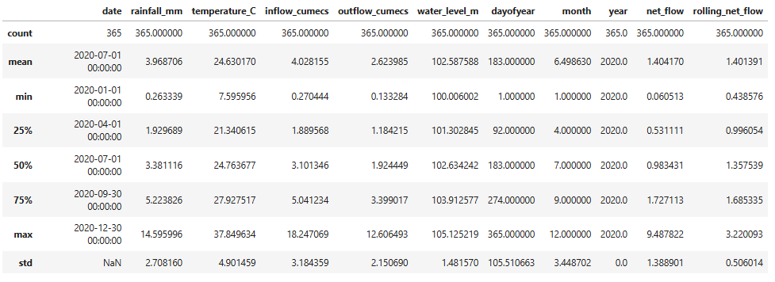
Statistics

Slide 4


Model Training & Validation
Testing Accuracy ~ 100 %

Slide 5
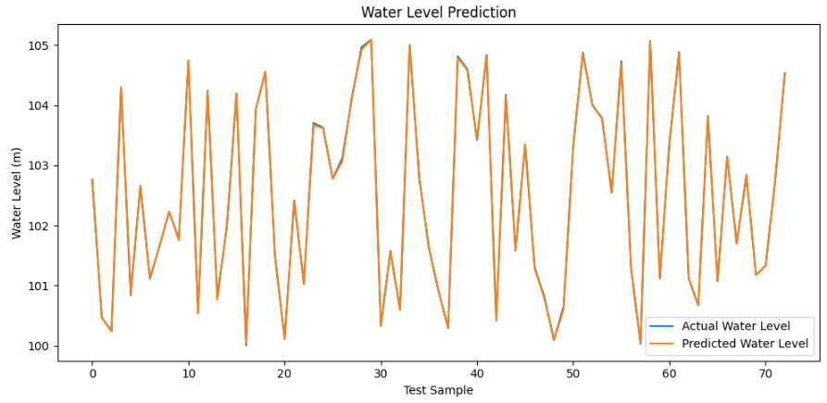
Water Level Prediction for test dataset

